Slide 1

DriverPass System Analysis
Jonathan Sussan

Slide 2

System Requirements
Functional Requirements
The system shall validate user credentials when logging in.
The system shall all a user to create, modify, or cancel a reservation.
Non-Functional Requirements
The data exchange between client and server shall be secured using industry standard encryption and SSL.
The system shall be compatible on all browsers, operating systems, and devices.
Notes:
There are more than just two functional and non-functional requirements for the DriverPass system. I highlighted the above requirements as I feel they are the most important ones.
Functional Requirements
The system shall validate user credentials when logging in. Validating user credentials is a must, as the user should have access to their account. The system needs to distinguish between a customer and admin. There are three levels of admin access as well which are owner, IT, and reception.
The system shall all a user to create, modify, or cancel a reservation. DriverPass’ business model revolves around customers purchasing driving packages. Allowing users to make reservations online and not have to call reception for help will increase sales and revenue as well as lower touch cost.
Functional Requirements
The data exchange between client and server shall be secured using industry standard encryption and SSL. Users should feel safe and secure when using the DriverPass system. Their sensitive data shall be kept safe and private.
The system shall be compatible on all browsers, operating systems, and devices. Users will login to the DriverPass system using various browsers, operating systems such as Windows, Mac, and Linux, and devices such as desktop, mobile, and tablets. It’s important to give users a great experience when using the DriverPass system no matter what or how they decide to login.

Slide 3
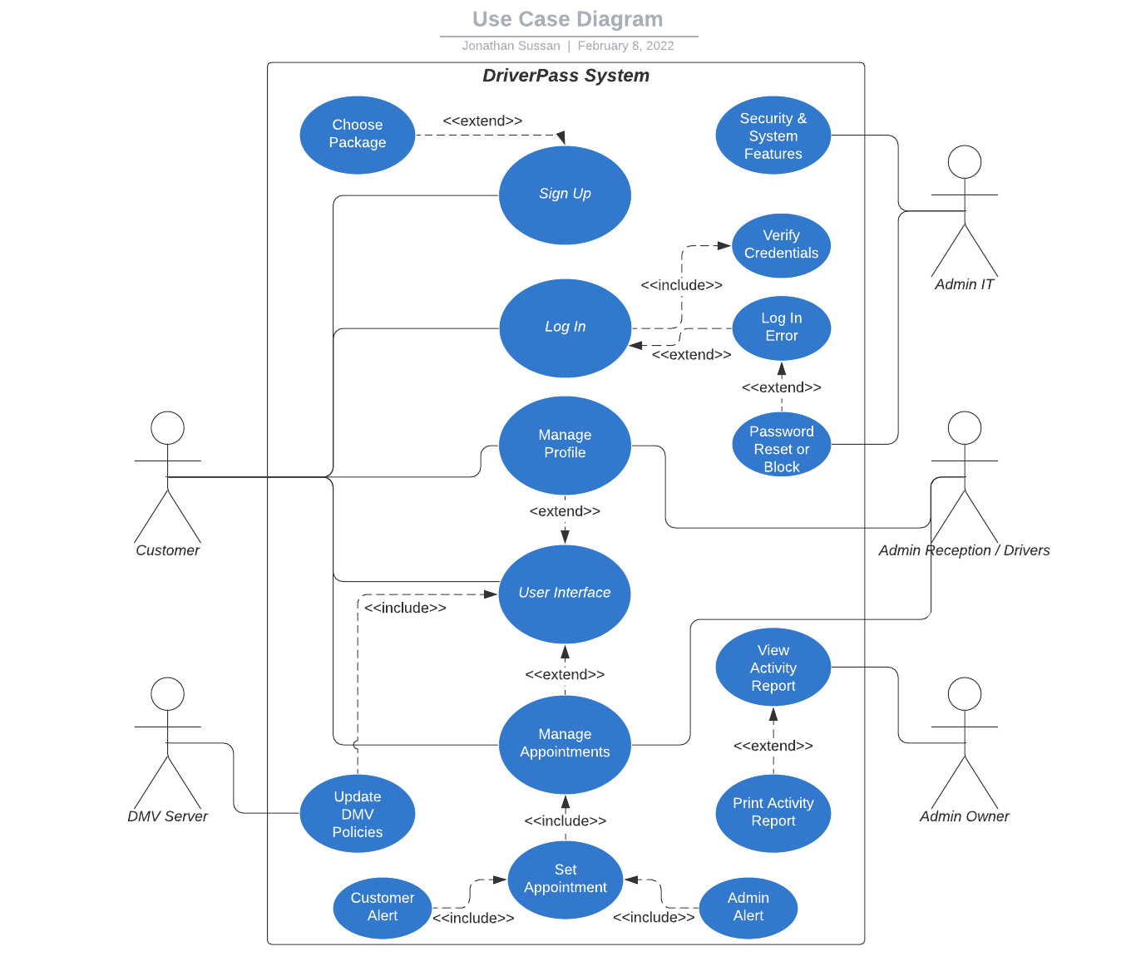
Use Case Diagram
Notes:
The Use Case Diagram above illustrates the DriverPass system. It labels the users of the system which are customer, admin owner, admin IT, admin reception/driver, and DMV server. The diagram shows how the users will interact with the system.
The customer shall be able to sign up, login, manage their profile, interact with the UI, and make/manage appointments.
The admin owner shall have full access but will mainly be operating viewing reports that are generated by the system.
The admin IT shall be interacting with the system’s security features, updates, account access, and password resets.
The admin reception shall manage customer accounts and appointments.
The DMV server shall feed any policy or law changes to the system database via an API connection.

Slide 4
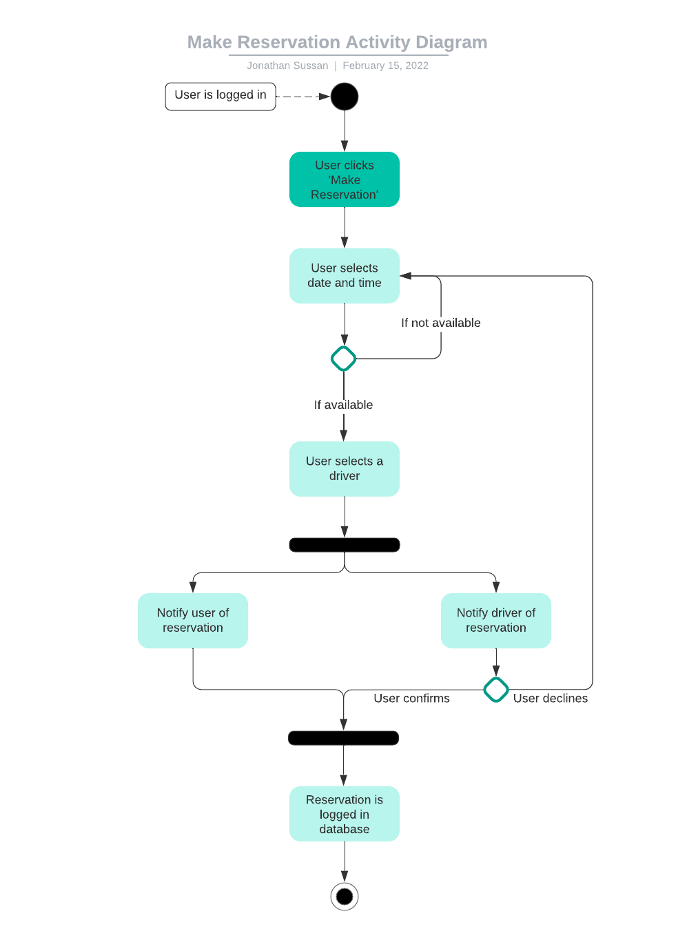
Activity Diagram
Notes:
The activity diagram above illustrates how users will make a reservation for a driving package with the DriverPass system. The diagram assumes a user is already logged in. A user shall click on ‘Make Reservation’. The user then selects a date and time for the reservation. If the date and time are not available, the system shall ask the user to select a different date and time. The user then selects a driver for the reservation. A notification is then sent to both the user and driver. Once the user confirms the notification, the reservation shall be logged in the database. If the user does not confirm, the system shall take them back to the select date and time page.

Slide 5
Security
The user shall be required to authenticate their credentials to login and use the system.
The data exchange between client and server shall be secured using industry standard encryption and SSL.
In defense of a “brute force” attempt, the system shall lock out accounts after a defined number of failed attempts.
In the case of a forgotten password, the system shall require a two-step authentication to reset the password.
Notes:
Security is one of the most important aspects we take into consideration when building a system. All data exchanged between the system and user shall be secured. When users create an account and input their sensitive data, they should feel safe that their data will be private which helps increase the user experience when using the DriverPass system.

Slide 6
System Limitations
The system is limited to three driving packages. While the DriverPass team will be able to enable/disable packages, they will not be able to create new ones.
Since the system will be web-based, an internet connection is necessary and offline use will not be available.
Users using outdated technology may experience lag or not be able to use the system.
Scalability due to DriverPass only having 10 drivers/cars.
Notes:
The system is limited to three driving packages. While the DriverPass team will be able to enable/disable packages, they will not be able to create new ones. To create a new driving package, DriverPass will need to hire an outside company.
Since the system will be web-based, an internet connection is necessary and offline use will not be available. If we enabled users to work on the system offline, duplicate entries can be made which will cause a bad user experience.
Users using outdated technology may experience lag or not be able to use the system. The DriverPass system is web-based which means users will need to have a good network connection for optimal use. The user may experience lag with a bad connection or not be able to use the system if they are using an outdated browser or hardware.
Scalability due to DriverPass only having 10 drivers/cars. Users may experience long wait times for a driving package reservation if too many users are using the system. DriverPass will need to increase the amount of drivers/cars to meet demand in this scenario to make for a good user experience.

